Slide 1

Intercultural Education
Workshops: Intercultural Education
Date: 14-15 January 2011, Warsaw
Participants: 2 groups of adults (11 + 10)
Female: 15
Male: 6

Slide 2

Intercultural Education
Challenges, Problems and their Origin
the reality of our societies: Difference
people are different in many ways and can be identified according to many criteria: gender, age, physical characteristics, sexual orientation, personality, hobbies, standard of living, beliefs, etc.

Slide 3
Intercultural Education
In this presentation we focus on cultural, social and ethnic differences. We will be looking at the interaction between people who are different, their lifestyles, values and cultures and the relationships between majorities and minorities in our societies. We will be working from the basis of difference: seeing different viewpoints, ideas, values and behaviour as the starting points from which to work towards common ground.

Slide 4
Intercultural Education
Questions:
- When did you first hear the expression „multicultural society”?
- What did it mean to you then?
- What does it mean to you now?

Slide 5
Intercultural Education
Local Minorities via Migrants, Immigrants, Refugees
Attention! A minority in one place can easily be a majority in another place.
In nearly every state there are „traditional” minorities: ethnic groups who have been present from centuries but who have different characteristics, manners, habits and ways of life from the majority

Slide 6
Intercultural Education
Migrants, Immigrants, Refugees
It is accepted practice in many European countries to talk of „migrants” as people who have origins in another country than they live at present. Some talk of „immigrants”, others of „guest workers” and some Council of Europe reports speak of „stocks of foreigner populations”.

Slide 7
Intercultural Education
Questions:
- When is a minority not a minority?
- When it is a powerful elite? Do you agree?
- How many people do you need to form a „minority group”?

Slide 8
Intercultural Education
From Multicultural to Intercultural Societies
at first sight, the terms „ Multicultural Society” and „Intercultural
Society” seem to be similar but they are not synonyms.
Multicultural Societies
different cultures, national, ethnic, religious groups all living within the same territory BUT not necessarily coming into contact with each other. A society where difference is often viewed negatively and forms major justification for discrimination. Minorities may be tolerated passively, but not accepted or valued.

Slide 9
Intercultural Education
Intercultural Societies
different cultures, national groups, etc. living together within a territory, maintain open relations of interaction, exchange and mutual recognition of their own and respective values and ways of life. We are talking about a process of active tolerance and the maintenance of equitable relations where everyone has the same importance, where there are no superiors or inferiors, better or worse people…

Slide 10
Intercultural Education
Culture
we are looking at the values and systems of bahaviour that allow groups of people to make sense of the world.
Few points:
the existing differences between cultures reflect the effort each society has had to make in order to survive within a particular reality.
even within cultures there are those who do not comply with all the usual norms and they may find themeselves identified as sub-cultures. Members of sub-cultures are often the victim of intolerance within our societies

Slide 11
Intercultural Education
We are born within a culture, and during the first stages of life we learn our culture. This process is reffered to as our socialisation.
Parents and family, school, friends and the mass media, particularly television- all of them contribute to the socialisation of children and, often, we are not even aware that we are part of this process.
Question:
What have been the biggest influences in your socialisation?

Slide 12
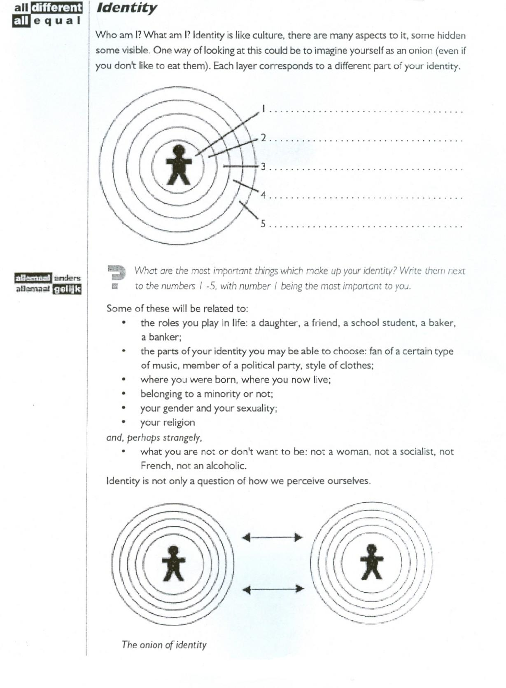
Intercultural Education

Slide 13
Intercultural Education
Stereotypes
Consist basically in shared beliefs or thoughts about a particular human group. A stereotype is an ensamble of characteristics that sums up a human group usually in terms of bahaviour, habits, etc.
The objective of stereotypes is to simplify reality: „they are like that” (eg. these people are lazy, those are punctual, etc). Sometimes we use stereotypes about the group to which we feel belong in order to feel stronger or superior to others
Question:
It has been suggested that we need stereotypes in order to survive.
How useful do you think they are?

Slide 14
Intercultural Education
Prejudices
A prejudice is a judgement we make about another person or other people without really knowing them. Prejudice can be negative or positive in character. Prejudices are learned as part of our socialisation process and they are very difficult to modify or eradicate. Therefore it is important that we are aware that we have them.Prejudices and stereotypes are schemes that help us to understand reality.
Question:
Why do you think prejudices are hard to change?

Slide 15
Intercultural Education
Discrimination
Discrimination is prejudice in action. Groups are labelled as different and discriminated against. They may be isolated, made criminals by law that make their ways of life illegal, left to live in unhealthy conditions, deprived of any political voice, given the worst jobs or no jobs at all, denied entry to different places, subjected to random police checks, etc.
Question:
Can you think of other examples of discrimination?

Slide 16
Intercultural Education
Xenophobia
Xenophobia comes from a greek word meaning „ fear of the foreigner”. This fear of the other is often translated into rejection, hostility or violence against people from other countries or belonging to minorities.

Slide 17
Intercultural Education
Intolerance
Intolerance is a lack of respect for practices or beliefs other than ones own. This is shown when someone is not willing to let other people act in a different way or hold different opinions from themeselves. Intolerance can mean that people are excluded or rejected beacuse of their religious beliefs, their sexuality, or even their clothes, etc.
Question:
When do you think that it is right to be intolerant?

Slide 18
Intercultural Education
Intercultural Education: A Positive Approach to Difference
Looking at:
the discovery of relationships
mechanism and resources
the school/ adults’ educational institutions
out of school/ adults’ educational institutions
stages in intercultural processes
using activities

Slide 19
Intercultural Education
We choose to use the term „intercultural”. Beacuse, as Micheline Rey points out, if the prefix „inter” is given its full meaning, this necessarily implies:
Interaction
Exchange
Breaking down barriers
Reciprocity
Objective Solidarity

Slide 20
Intercultural Education
„The discovery of others is the discovery of a relationship, not of a barrier” (Claude Levi-Strauss)
The targets of intercultural education are:
To further an understanding of the reality of an independent world and encourage action coherent with that reality
To go beyond negative prejudices and ethnic stereotypes
To favour a positive evaluation of difference and diversity
To search for a highlight similarities
To generate positive attitudes and habits of behaviour towards people from other societies and cultures

Slide 21
Intercultural Education
Intercultural education with young and adult people works in two major ways:
To help them gain the capacity to recognise inequality, injustice, racism, stereotypes and prejudices
To give them the knowledge and abilities which will help them to challenge and to try to change these mechanisms whenever they have to face them in society

Slide 22
Intercultural Education
Informal Intercultural Education
Informal education has several important features which distinguish it from formal education:
- Informal education is voluntary, it does not have the obligatory character and providers have to make greater efforts to sustain the interest of participants
- In informal education there is a closer relationship with participants, and this makes communication easier (if at times more stressful!)
- The contents are adapted with participants to their reality and needs
- The active and participative methodology applied in informal education makes for greater participation

Slide 23
Intercultural Education
Working with Adult People- A Continuous Process
Intercultural education has to enable adult people to discover the origins and mechanism of intolerance, xenophobia or prejudices. Personal discovery can lead to collective action and it is up to facilitate this process.
We have chosen, in a simplified way, to compare the intercultural education process to a road in which there are different stages that, simultaneously, are centres of interest to work on.

Slide 24
Intercultural Education
These are:
- To imagine yourself from the outside
- To understand the world we live in
- To be acquainted with other realities
- To see difference positively
- To favour positive attitudes, values and behaviour
Notice: Intercultural education is not a closed program that may be repeated without continuous modfifications!

Slide 25
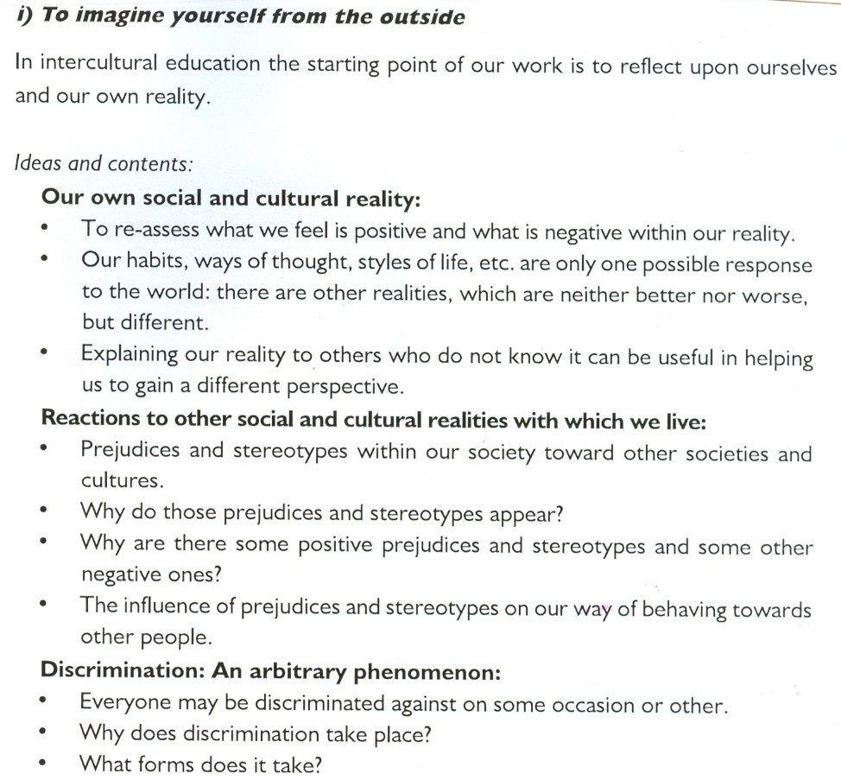

Slide 26
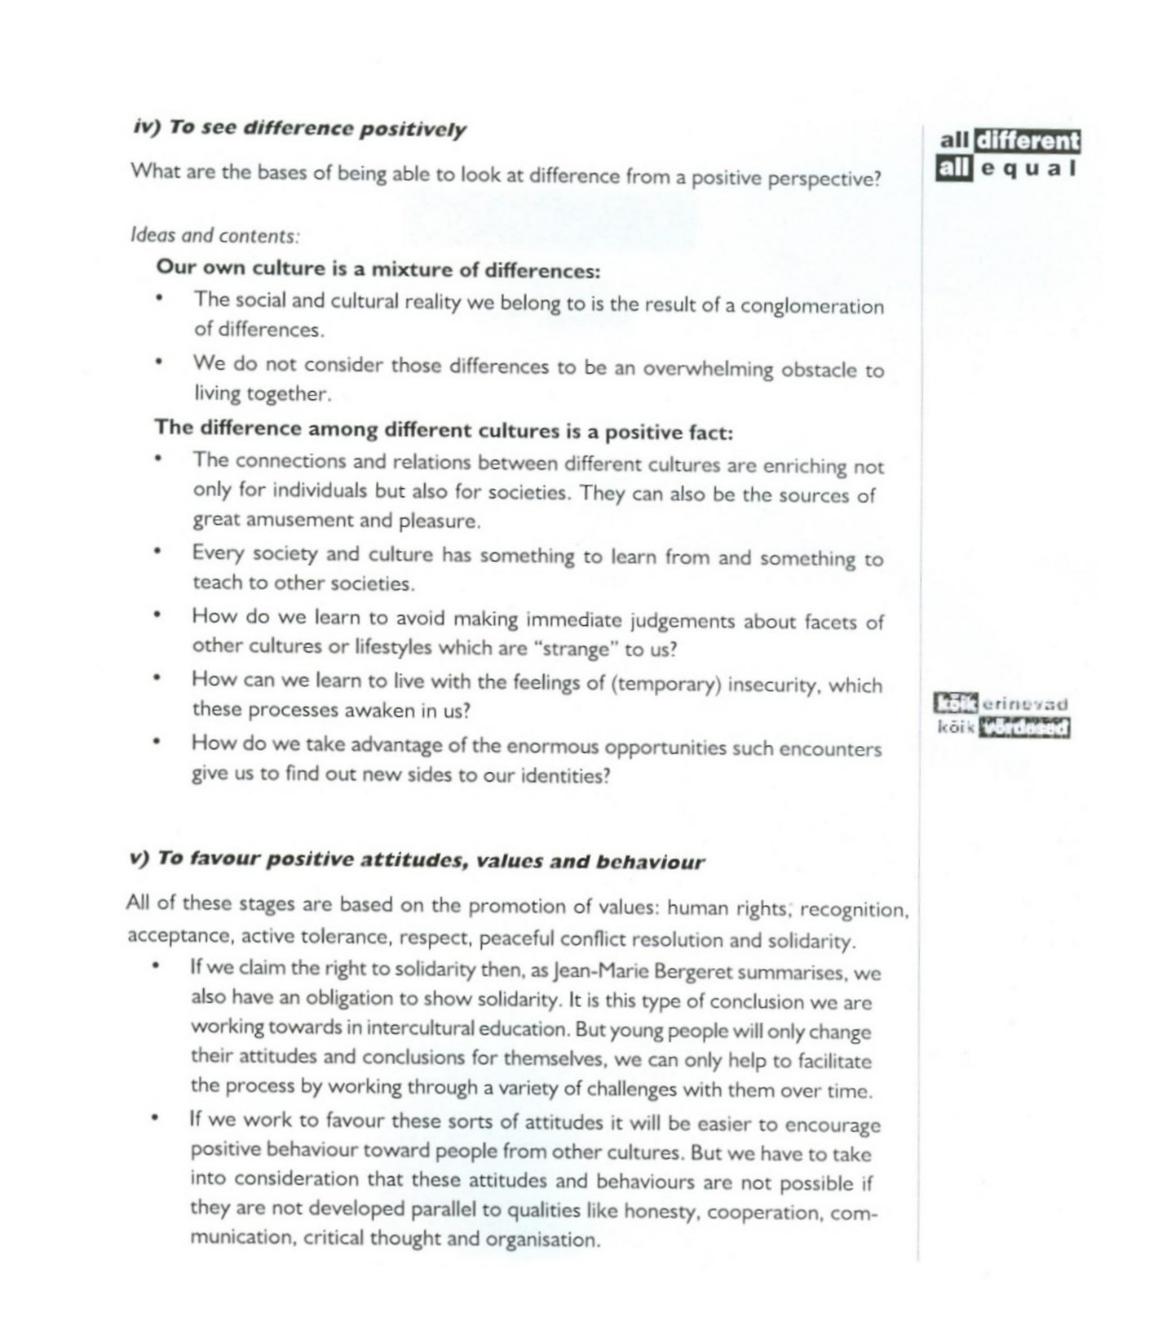

Slide 27
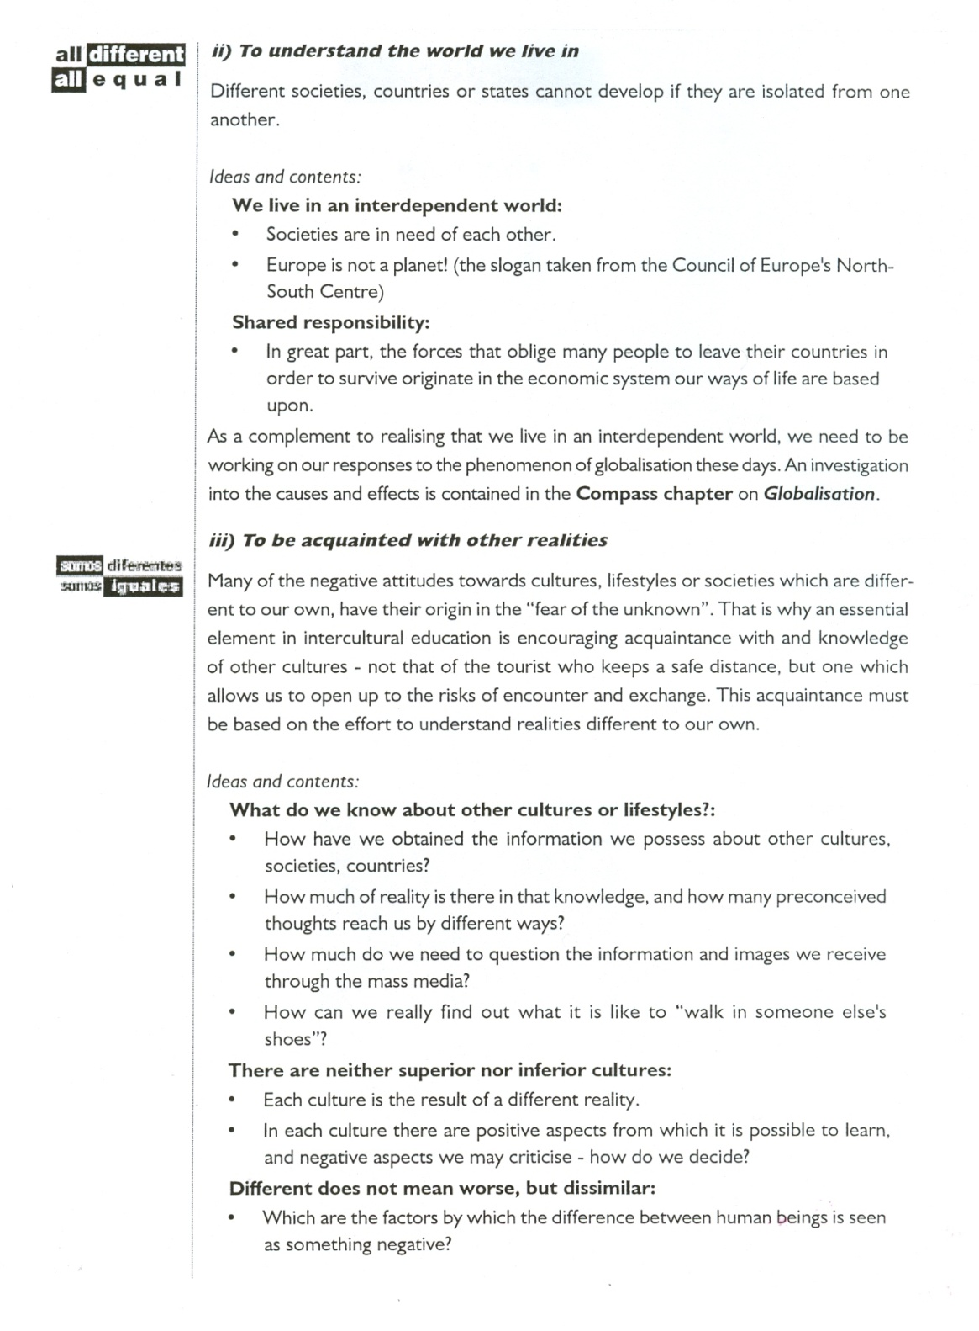

Slide 28
Intercultural Education
To help us know how and where to place the limits of each informal intercultural education activity we should try to be aware of the following factors:
- The content and the extent of the activity we are intending to organise
- The context in which we are going to work and the limits it imposes on us
- The level of acquitance and relationship we have with the adult people with whom we are going to work
- The level of participation in the activity- the meaning of the activities should start and must be reffered to the participants’ daily life.

Slide 29
Intercultural Education
To sum up, it may be helpful to remember that:
- Starting from an active and dynamic methodology…
- We work in processes…
- Through which and by means of information, analysis and critical reflection of reality…
- The participants in our work will find ways to:
- Interact with people from other cultures positively in their daily life
- And will devise strategies to transfer that positive relation with people from other cultures into individual or collective actions.

Slide 30
Intercultural Education
Activities, Methods and Resources
The activities of the educational programme have been written for anyone working with adults in out of school or informal educational activities in issues of equality, racism, xenophobia or intolerance.
We have identified the activities according to four themes that follow a sequental educational process:

Slide 31
Intercultural Education
G- activities will help to create a good group atmosphere and reinforce communication skills and group dynamics
I-activities which work with the images we have of people from cultures, countries or social origins different from our own
M-activities which explore the social, economic, cultural or educational mechanisms the lie behind situations of discrimination, refusal, exclusion and marginalisation
A-activities which encourage people to act to bring about social change based on values of equality and the acceptance of „difference”

Slide 32
Intercultural Education
The educational approach
The activities in this programme have been designed to enable to work within intercultural education issues from two perspectives: participation and group work.
Taking a participatory approach imlpes that adult people (migrants) are not the target of our work, but that they are the resources we count on. Our main task and challenge is to encourage migrants to take control of their own actions and thereby to empower them.
Group work is an appropriate way for people to gain a deeper understandig and ownership of their experience, knowledge, skills and attitiudes.

Slide 33
Intercultural Education
Dealing with conflict
It is possible that some conflicts may arise during the activities. We are asking people to explore very difficult and challenging issues, encouraging them to express their opinions and to think critically, this is part of the intercultural education process, but it is never easy and can be extremely stressful.
Situations which could lead to conflicts that break the educational process should be avoided if possible.

Slide 34
Intercultural Education
Our role as the facilitators:
- be aware of each person in the group and any sensitive emotions that might be trigerred by a particular activity or by a particular part in a role play or simulation
- make sure everyone knows that they are at no time under any pressure to say more or reveal anything about themeselves other than that which they feel comfortable with
- allow participants time to warm up before any activity and time both at the beginning to get into, and at the end to get out of the role
- allow enough time for debriefing and discussion.

Slide 35

Thank you for your kind attention ☺

